Slide 1
COVID-19 Impacts on North Carolina Traffic
Kerry Morrow, NCDOT Traffic Survey Group
December 2, 2020

Slide 2
Welcome
Impacts to 2020 data collection
COVID-19 timeline
NC travel trends
How will it impact 2020 data analysis?
2021 data collection plans
Today’s Presentation
A strategic transportation plan connecting communities across North Carolina, focused on creating a more responsive, diverse, and inclusive transportation system for keeping people and freight moving safely and efficiently.

Slide 3
COVID-19 Impacts on North Carolina Traffic
2020 Data Collection
Factors:
Traffic monitoring program consists of ~53,000 data collection stations
NCDOT cash balance was very low; no overnight travel allowed
Uncertainty regarding safety
HR provisions
Impacts:
Stopped short-term data collection for 7 weeks from mid-March to end of May 2020
Resumed with limited productivity
Significant cuts in short-term data collection for 2020

Slide 4
COVID-19 Impacts on North Carolina Traffic Traffic
2020 Data Collection
Collection priorities:
Safety – Top Priority
No overnight lodging
Minimum number of stations collected
More day trips
Gathering a sample of stations
Primary Routes (US & NC)
Collect once
While school is out of session
Collect a second time if possible
While school is in session
Secondary Routes & some Local Routes
Collect to provide additional analysis as needed
Cancel collections that can be postponed and/or can be estimated
Canceled Blue Ridge Parkway Collection
Canceled Interstate/Freeway Ramp Collection

Slide 5
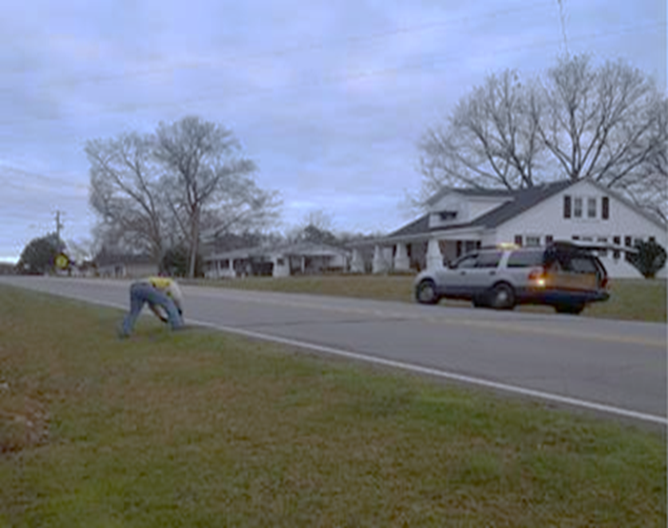
COVID-19 Impacts on North Carolina Traffic
2020 Data Collection
Short-term Volume Collection
24,275 stations scheduled for 2020
Pneumatic tube counters, 48-hour counts
Replaced with sample of ~7,000 stations
Short-term Class Collection
1,033 stations scheduled for 2020
Pneumatic tube counters, 48-hour counts
No adjustments made

Slide 6
COVID-19 Impacts on North Carolina Traffic
2020 Data Collection
Interstate Collection
80 stations
Temporary radar installed for 7-day counts
Reduced to 47 stations
2,921 ramp stations
Pneumatic tube counters, 48-hour counts
No ramps collected in 2020
Will utilize factoring to perform ramp analysis with mainline control collections
Continuous Collection
100 locations in NC (24/7/365)
Permanent Radar, no interruptions in collection
Will utilize data set for factoring other collected data sets

Slide 7
COVID-19 Timeline Key dates for COVID-19 mitigation in North Carolina
COVID-19 Impacts on North Carolina Traffic
March 10 Emergency Declaration
May 8 Phase 1 Reopening
March 17 Bars & Restaurants Closed
2020
March | April | May | June | July | August | Sept | Oct
March 30 Stay at Home Order
May 22 Phase 2 Reopening
October 2 Phase 3 Reopening
March 14 Public Schools Closed
September 4 Phase 2.5 Reopening

Slide 8
North Carolina Travel Trends
North Carolina
Travel Trends

Slide 9
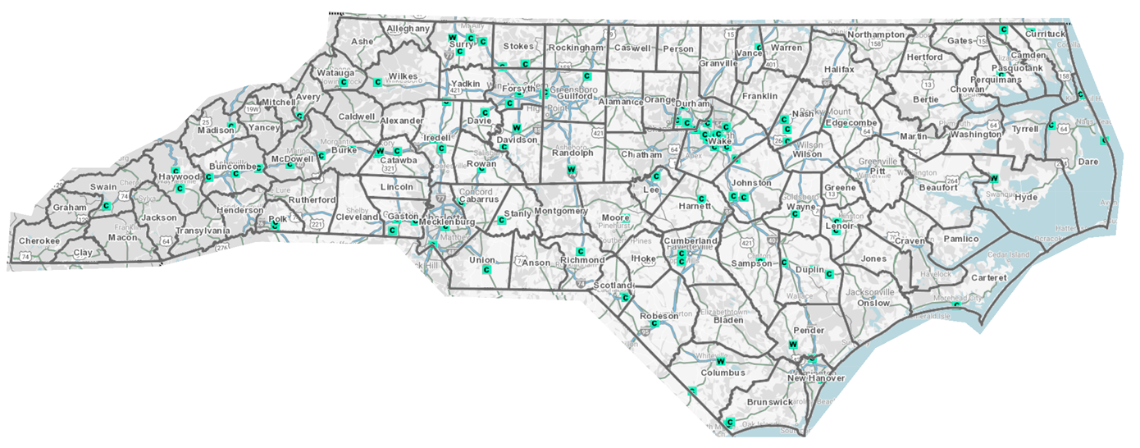
Travel Trend Reporting
COVID-19 Impacts on North Carolina Traffic
NCDOT Leadership asked for weekly reporting of travel trends
Trends based on Continuous Count Stations
Data now on NCDOT dashboard (except VMT)
NCDOT Continuous Count Stations
Notes:
As of last week, this data is available on the NCDOT dashboard.
This map shows our 100 continuous site locations in NC. As you can see, we have them spread (albeit a little unevenly) in urban and rural areas. We are working on installing more continuous sites to provide a richer data set.

Slide 10
Volume Trend – Weekly Change
COVID-19 Impacts on North Carolina Traffic
Weekly Change: Average of daily changes from Pre COVID volumes
2020
March
April
May
June
July
August
September
October

Slide 11
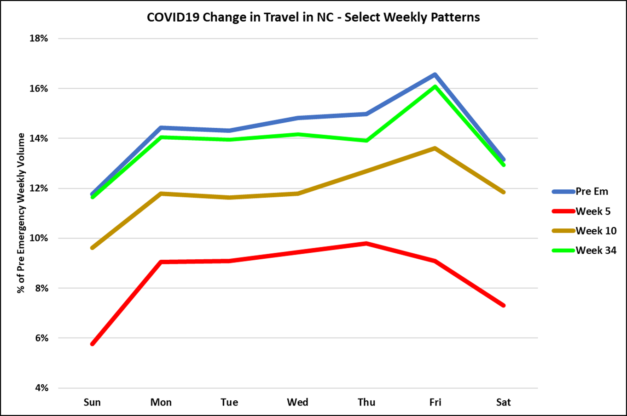
Volume Trend – Day of Week
COVID-19 Impacts on North Carolina Traffic
Compares day of week impacts for selected weeks

Slide 12
Volume Trend – Type of Route
COVID-19 Impacts on North Carolina Traffic

Slide 13
Travel Trend – Based on VMT
COVID-19 Impacts on North Carolina Traffic
A statistic used to measure travel is Vehicle Miles Traveled (VMT), generated by multiplying the length of a highway segment with its volume.
2018 VMT stats:
US VMT was about 3.3 Trillion
NC VMT was about 121 Billion
Average monthly NC VMT was about 10 Billion
VMT varies by Day of Week
Lowest travel day in NC is typically Sunday around 300 Million
Highest travel day in NC is typically Friday around 420 Million
Statewide Daily VMT will vary due to seasonal variation, holidays, adverse weather, and major events.

Slide 14
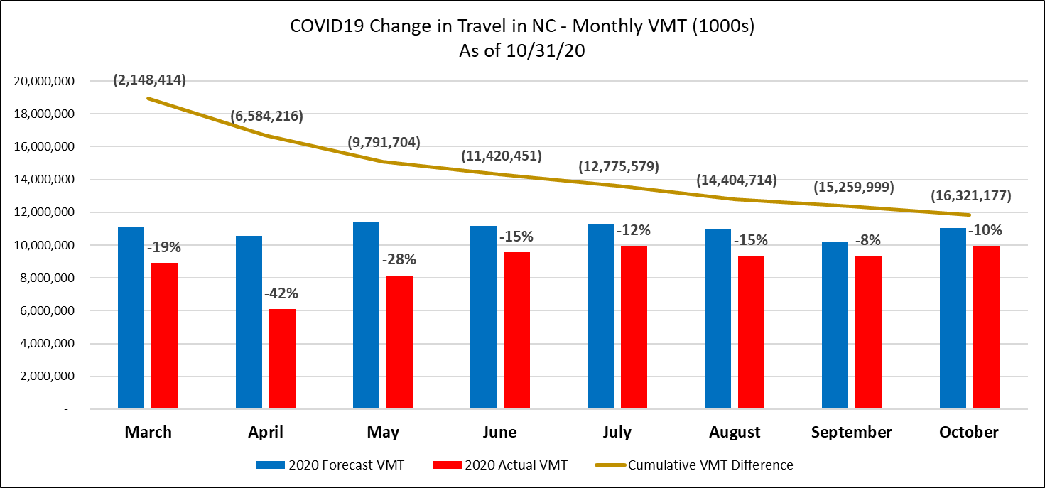
Travel Trend – Monthly
COVID-19 Impacts on North Carolina Traffic
As of end of October, we have 16 Billion less VMT than forecasted

Slide 15
How will it impact 2020 Data Analysis?
COVID-19 Impacts on North Carolina Traffic
HPMS Deadline June 15, 2021
FHWA guidance
Pre-COVID-19 collected counts and prior year data can be used for comparison
Look at best practices from peer states in figuring out adjustment factors to annualize data
Bottom line: 2020 will have significantly higher number of stations with estimated counts than other years

Slide 16
2021 Data Collection Plans
COVID-19 Impacts on North Carolina Traffic
Travel will still be impacted by COVID-19
Anticipating possible new mitigation controls
Not anticipating new HR provisions
Planning for more data collection, less need to apply adjustment factors
Anticipating (hoping!) 2021-2022 schoolyear will be back to normal

Slide 17
COVID-19 Impacts on North Carolina Traffic
Thank you!
Questions? Contact us!
Kerry Morrow
NCDOT Traffic Survey Group Supervisor
kmorrow@ncdot.gov
Kent Taylor
NCDOT Traffic Data Resource Engineer
kltaylor@ncdot.gov

